Slide 1
MASTERPIECES OF WESTERN ART Art Humanities W1121 Section 15
Michelangelo
(Part 2)

Slide 2
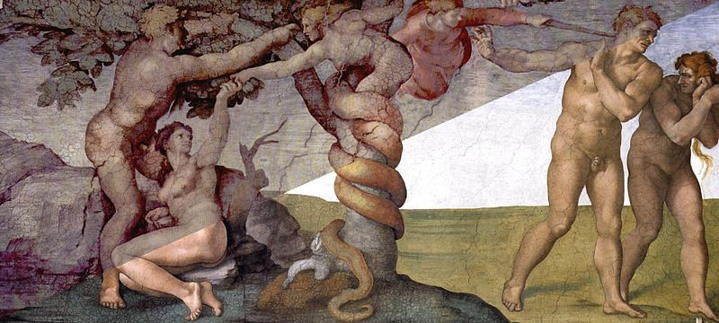
The Temptation and Expulsion
Left corner before restoration
Right corner after restoration

Slide 3
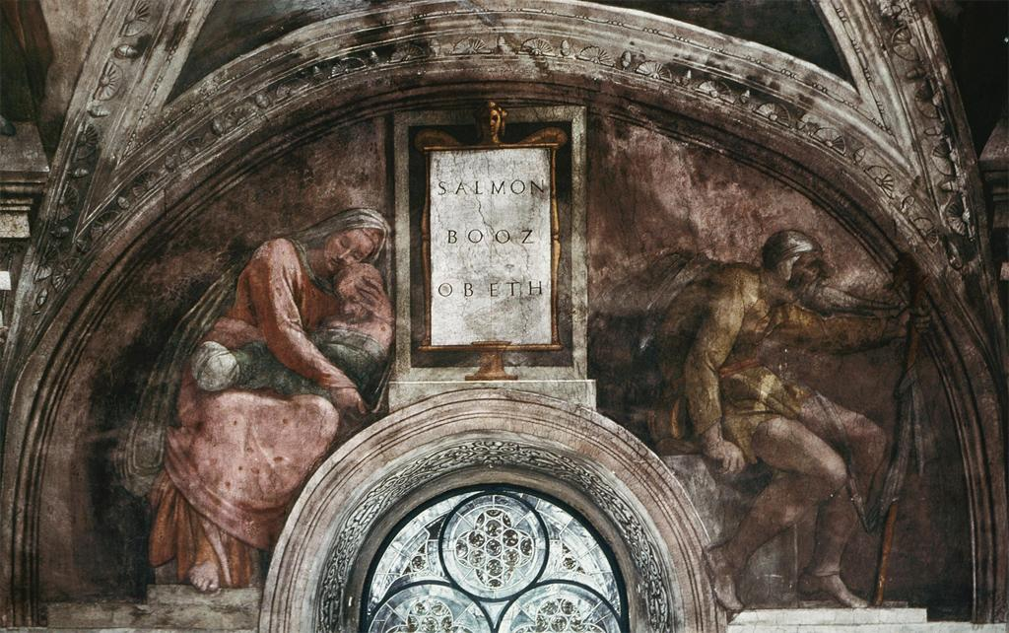
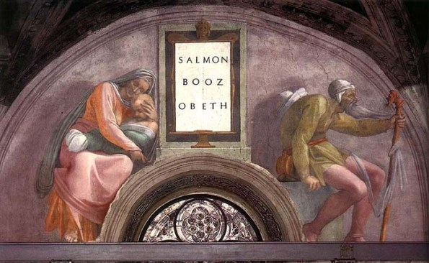
Salmon Booz Obeth
Detail of Ruth/Naomi and Child
before restoration
Detail of Ruth/Naomi and Child
after restoration

Slide 4
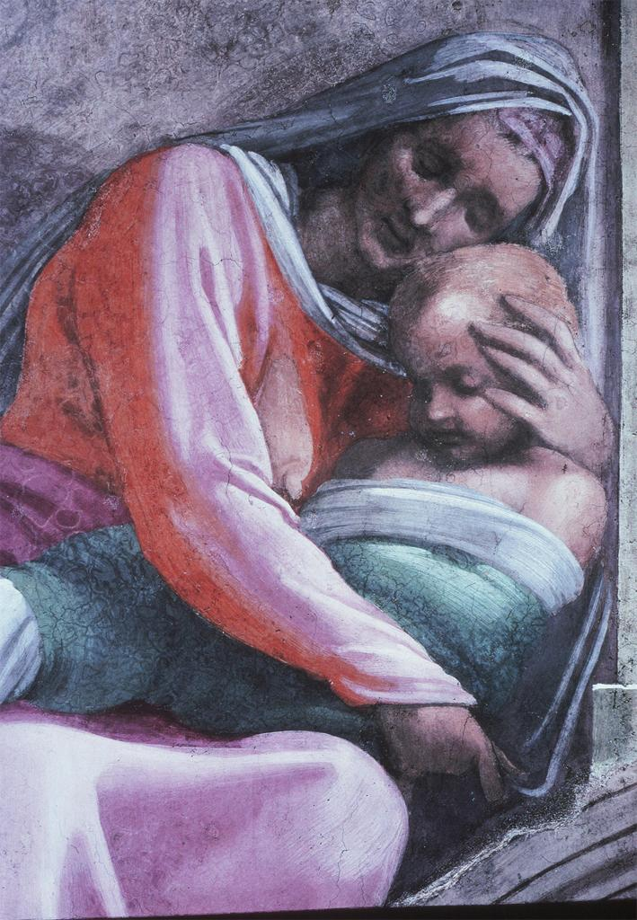
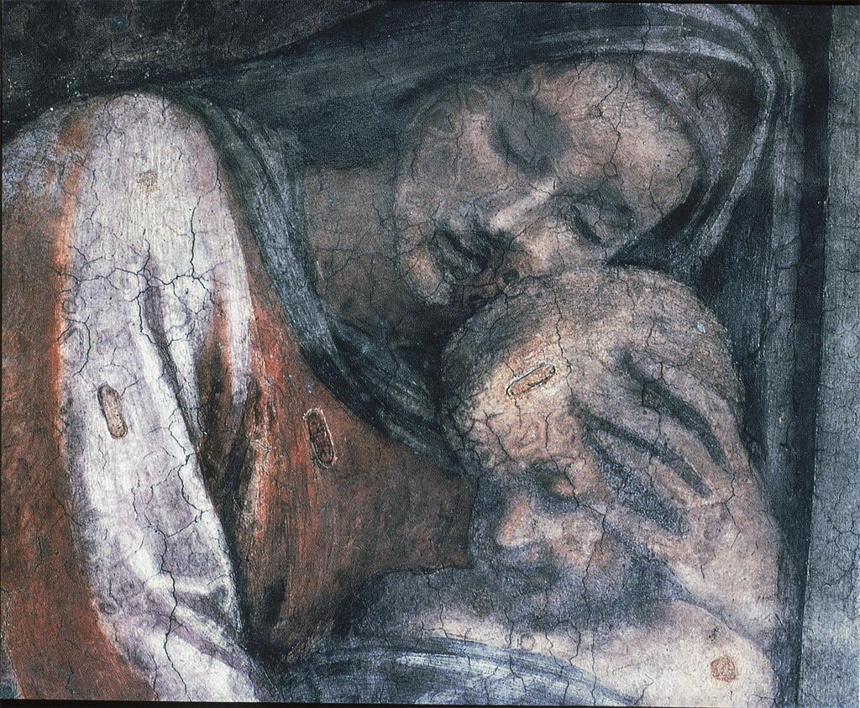

Slide 5
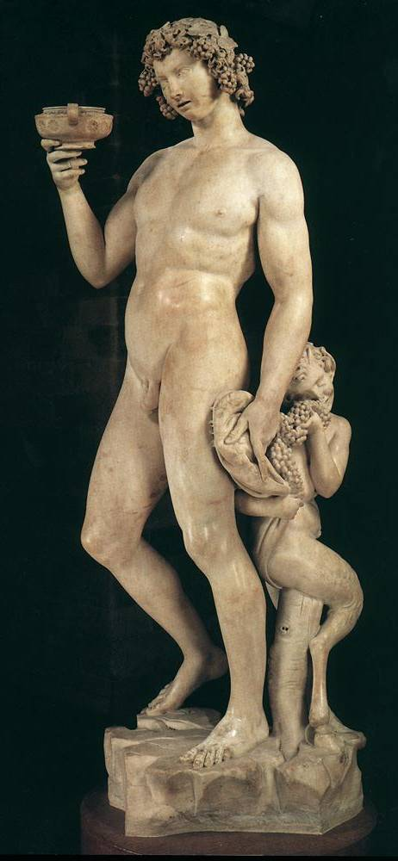
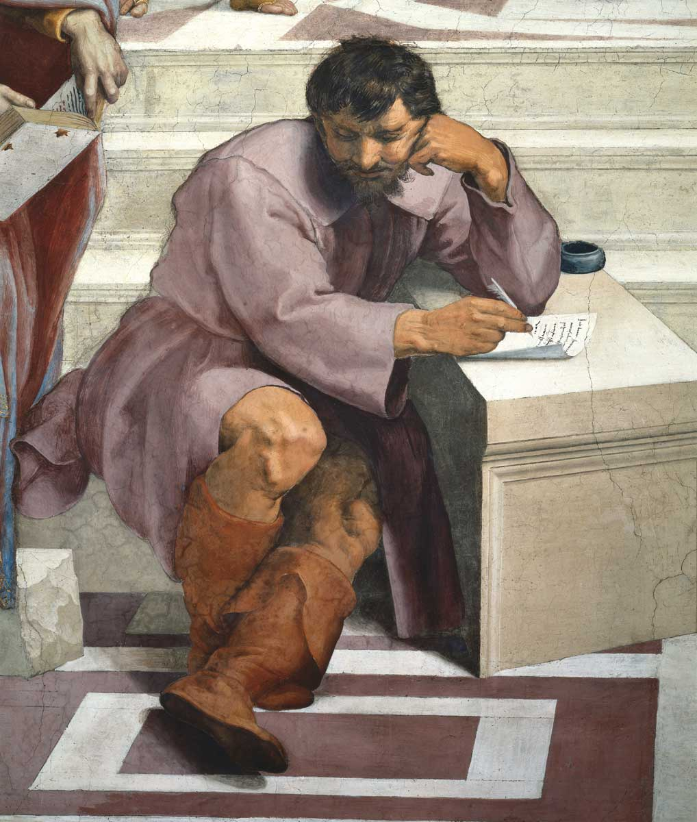
Michelangelo
Bacchus
1496-97

Slide 6
Michelangelo
Bacchus
1496-97

Slide 7
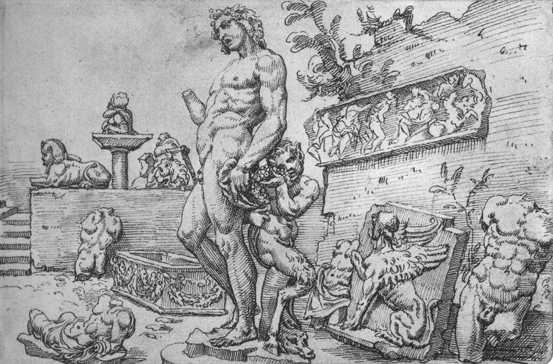
Van Heemskerck
Michelangelo’s Bacchus
Engraving
Mid 16th century
Michelangelo, Bacchus

Slide 8
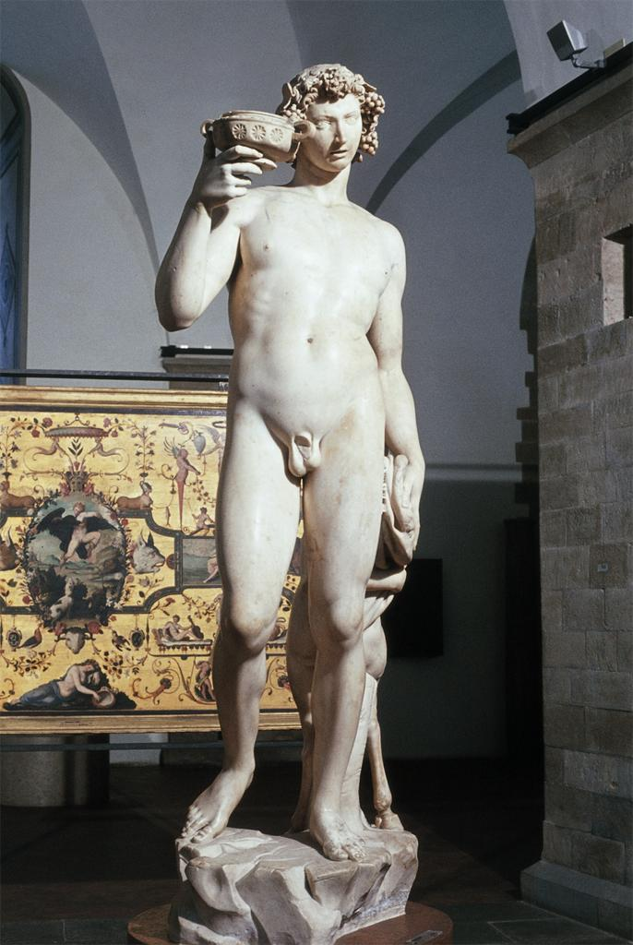

Slide 9
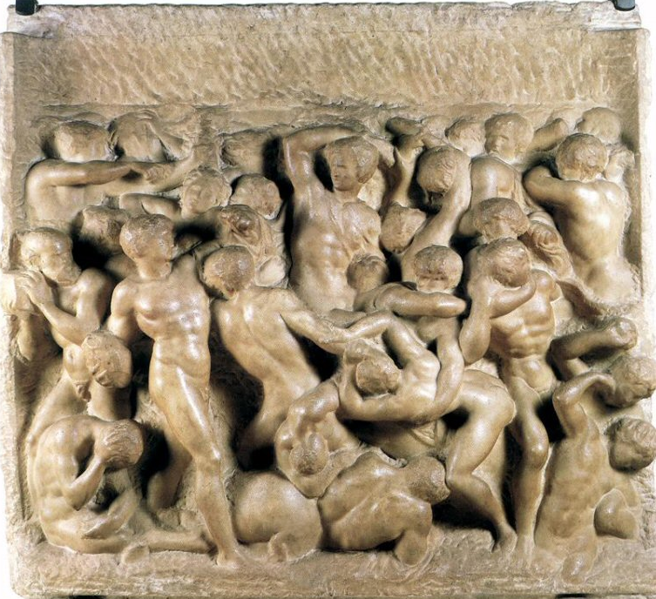
Michelangelo, Battle of Lapiths and Centaurs, 1492

Slide 10
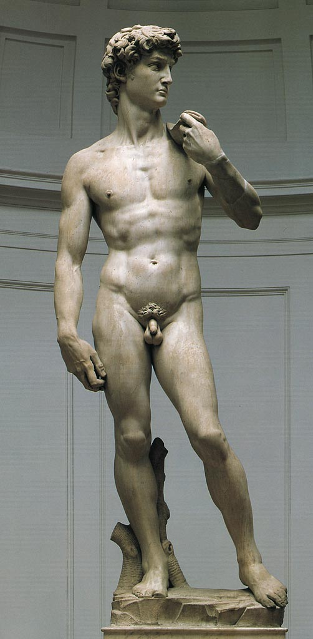
Michelangelo
David
1501-04

Slide 11
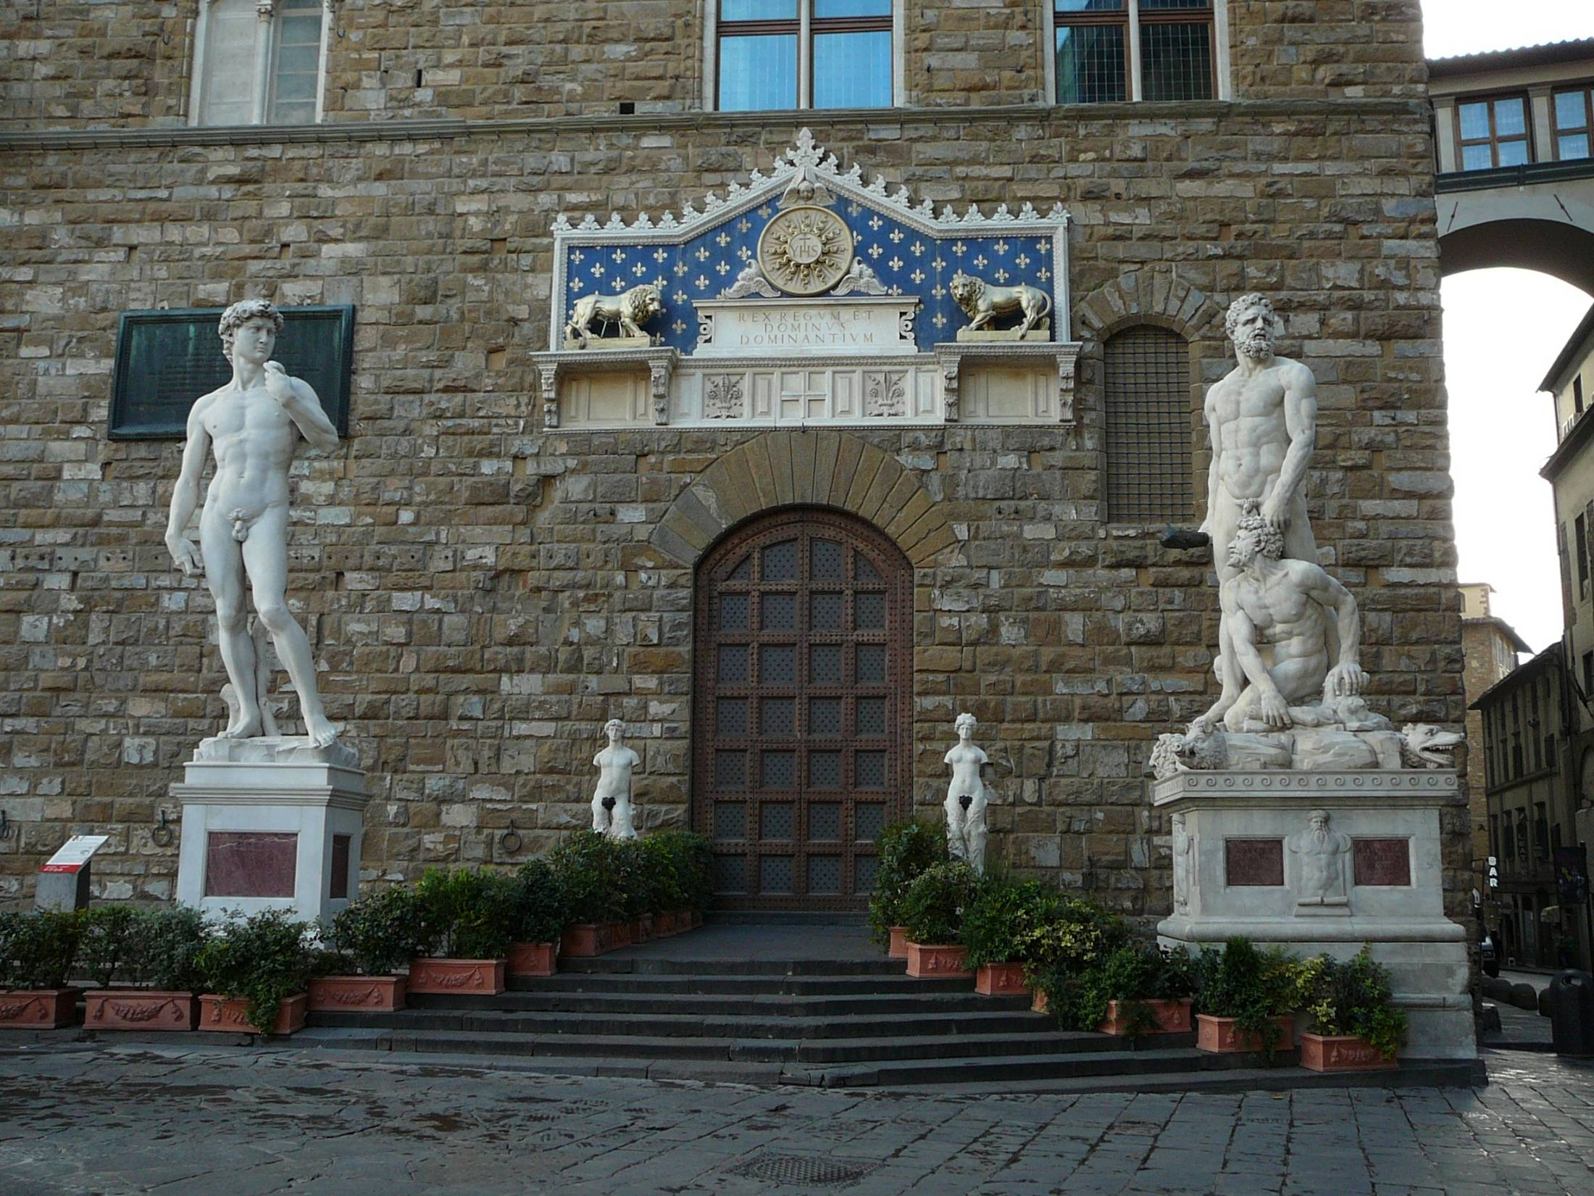
Entrance of the Palazzo Vecchio (City Hall), Florence

Slide 12
Michelangelo
David
1501-04

Slide 13
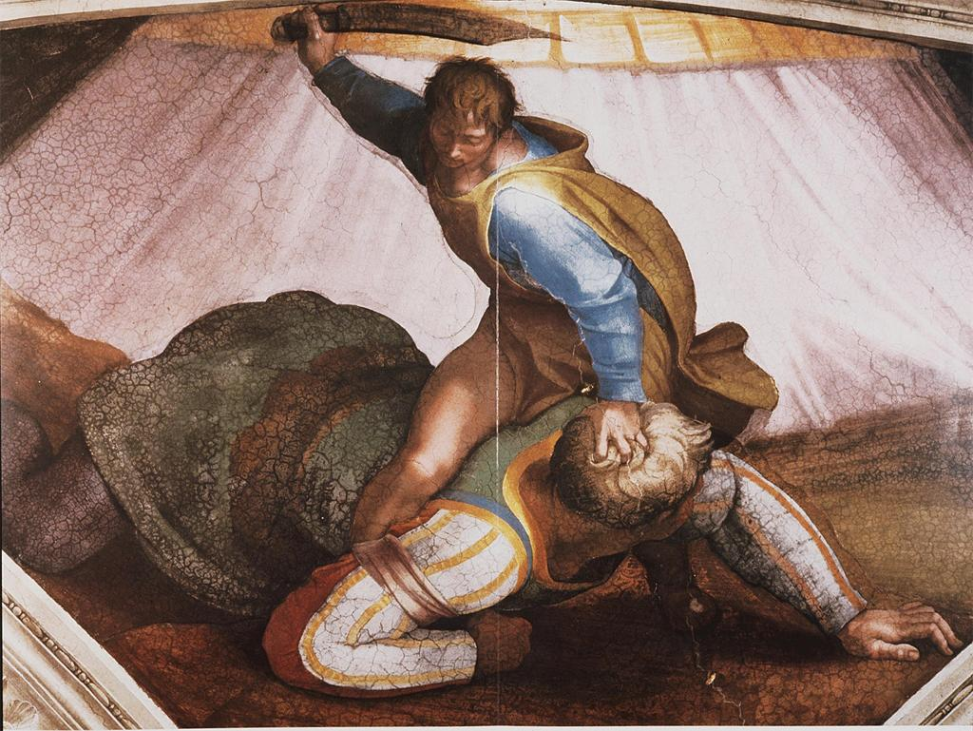
Michelangelo
David
1501-04
Michelangelo
David and Goliath
Sistine Chapel Ceiling, 1508-12

Slide 14
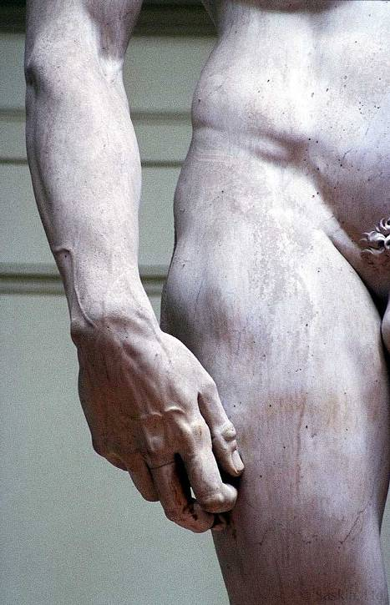

Slide 15
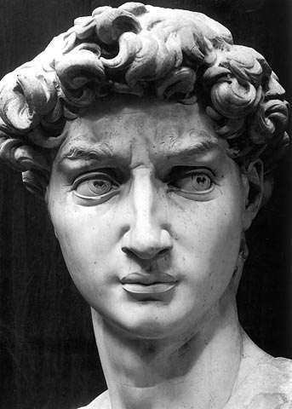

Slide 16
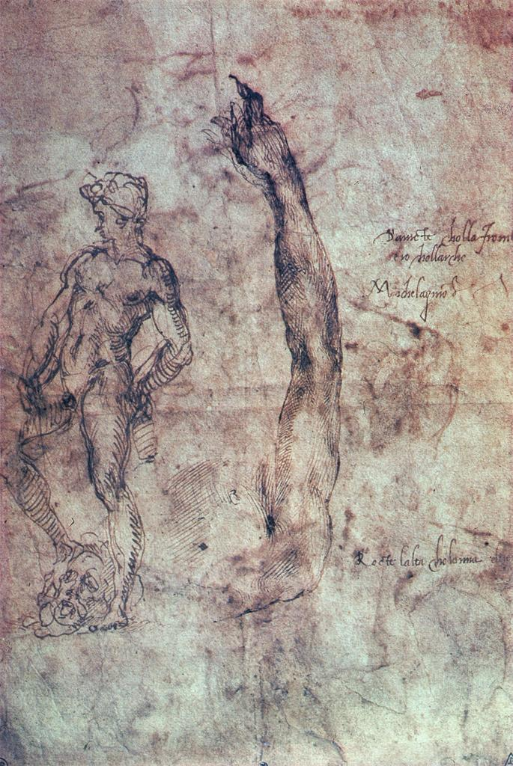
Michelangelo
Studies for David and verse

Slide 17
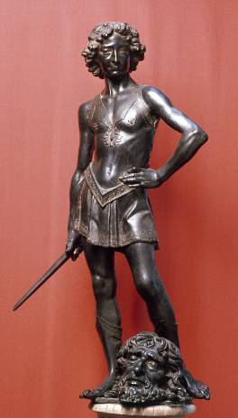
Verrocchio, David, early 1470s’

Slide 18
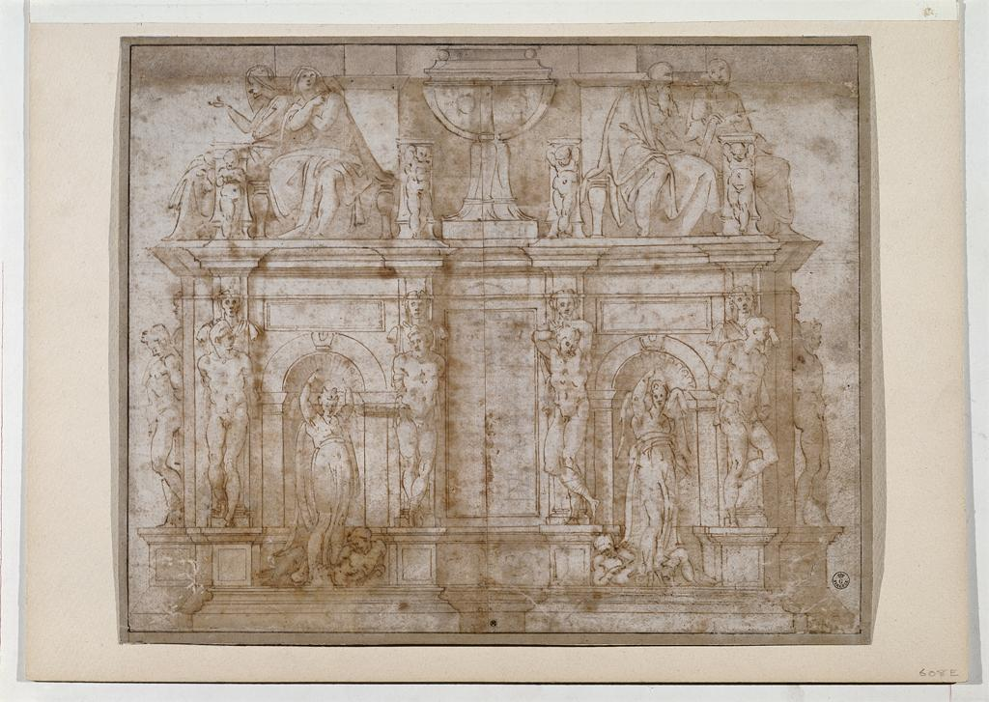
Michelangelo, Design for the Tomb of Julius II, not dated

Slide 19
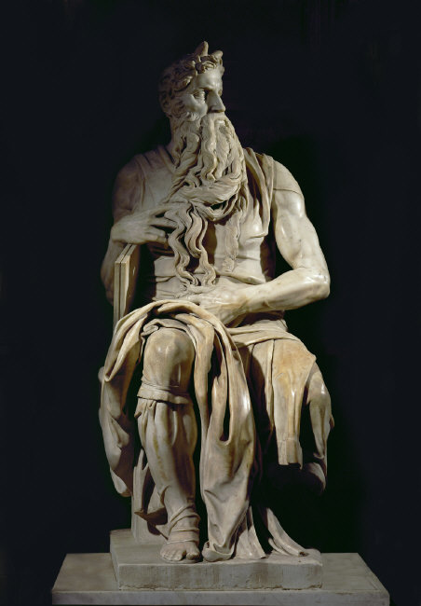
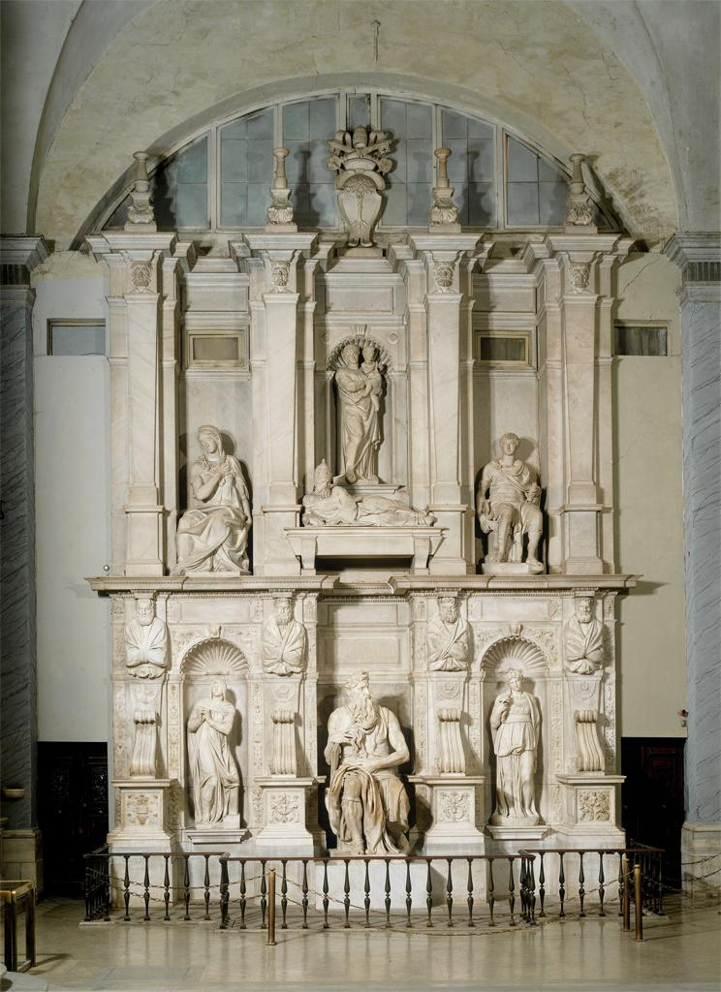
Tomb of Julius II
1505-45
Michelangelo, Moses, c. 1515

Slide 20
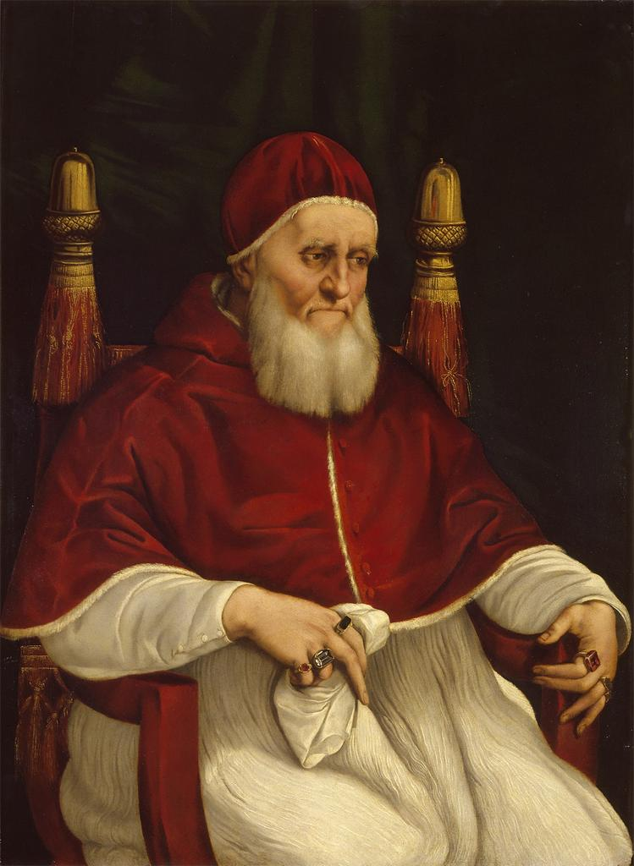
Raphael
Portrait of Julius II
1511

Slide 21
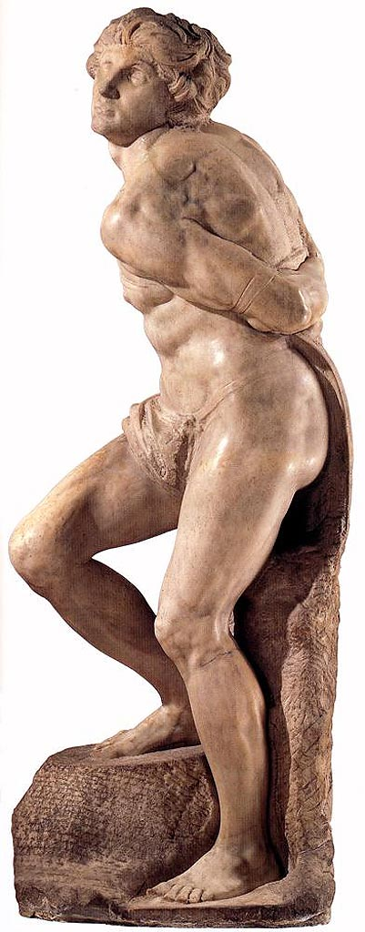
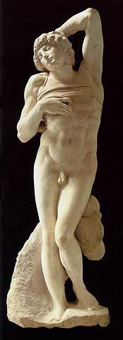
Michelangelo
Rebellious Slave
c. 1515
Dying Slave

Slide 22
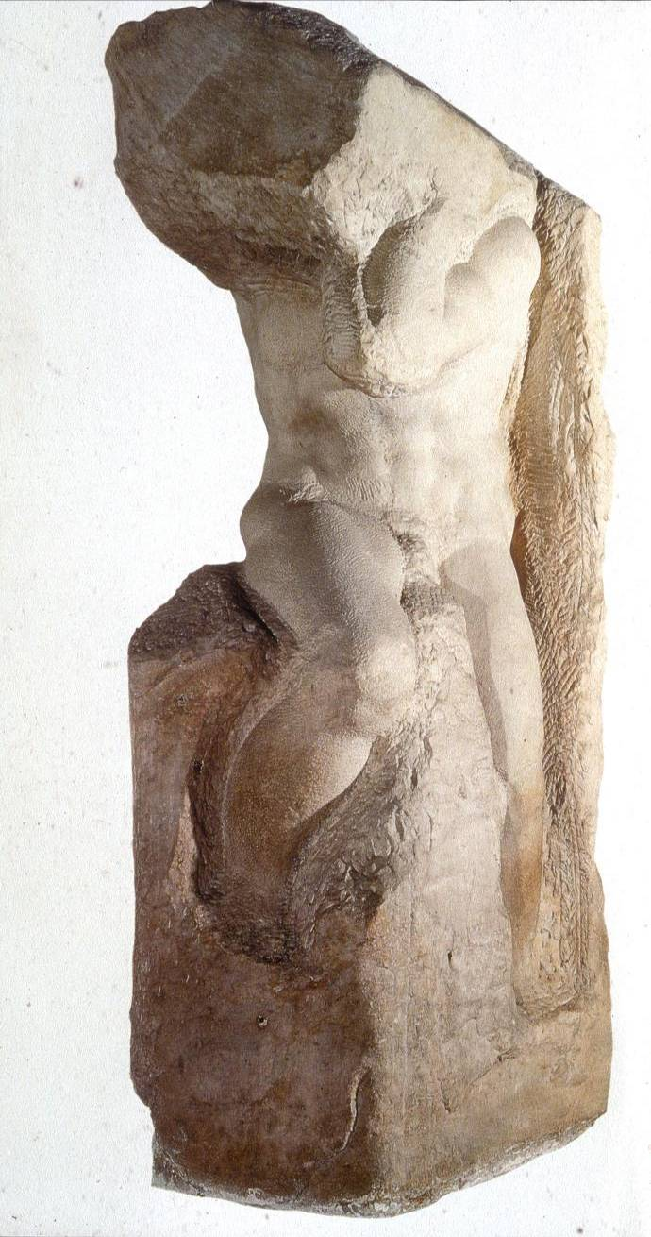
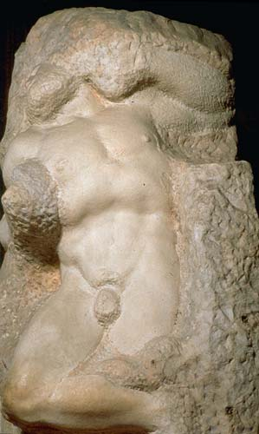
Atlas Slave
Awakening Slave

